Slide 1
Finemate
Learning is a Piece of Cake.

Slide 2

Students
Communities
Knowledge
Effortless
Digital Infrastructure
Dopamine
Learners
Institutes
Revision
Pocket Money
Mental Health

Slide 3
Problem
Students & Professionals often forget things that they have just learned. Do you also face this problem?
Decreased Attention span of students but the same old long seminars teaching approach.
Students don’t understand one analogy so they can understand that concept from some other analogy figuring out what to watch in a few seconds.
Institutes in small cities lack a student management system and those who have are outdated.

Slide 4
Solution
Retention Engine
Social Learning Platform
Student Management System
It helps you to learn better and retain better by algorithmically understanding who you forget often and what not.
A platform for online learning communities so they can clear there doubts, learn together and teach each other what they have excelled.
A Super app that fulfills all the common requirements of Institutes.
1
2
3

Slide 5
So, Are we building any medicinal solution for Retention ?

Slide 6
How Retention Engine?
By a combination of small solutions like Interacting Newsfeed, AI powered diagram builder, Positive Reinforcement, etc. tools that will make you retain whatever you have learned in class or online.
Thought: It’s a Psychological Solution implemented in Software.

Slide 7
Humans forget 42% of learnings in just 20 minutes and after 60 days only 10% of things are retained when not practiced.
- Herman Ebbinghaus 1885 (translated)
Memory
Time Remembered
Thought: That’s of 1885 what about 2022 when there are more distractions and a low attention span.

Slide 8
What affects Cognition?
Cognitive Load
Difficulty Level
Confusion
Prior Knowledge
Language Barrier
Curiosity
Active Memory
Teaching Methods
Distractions
?

Slide 9
How Social Learning Platform?
By creating specific communities for specific learners, people creating illustrations, analogies, mnemonics and teaching better.
Also asking questions anonymously in communities.

Slide 10
Gyan Batne se badta hai!
Translate English
knowledge increases by sharing.
- Indian Proverb

Slide 11
How Student Management System ?
By creating a Cool Student Friendly Student Management System with some advanced features which notifies students on everything because today along with low attention span we are also notification controlled.

Slide 12
Target Audience & Benefits
Institutes
Improving the students performance eventually benefiting Institutes.
Providing a Technically Advance Student Management System.
Individuals
Helps students to learn better and retain better.
Builds a learning community to share expertise and experience.

Slide 13
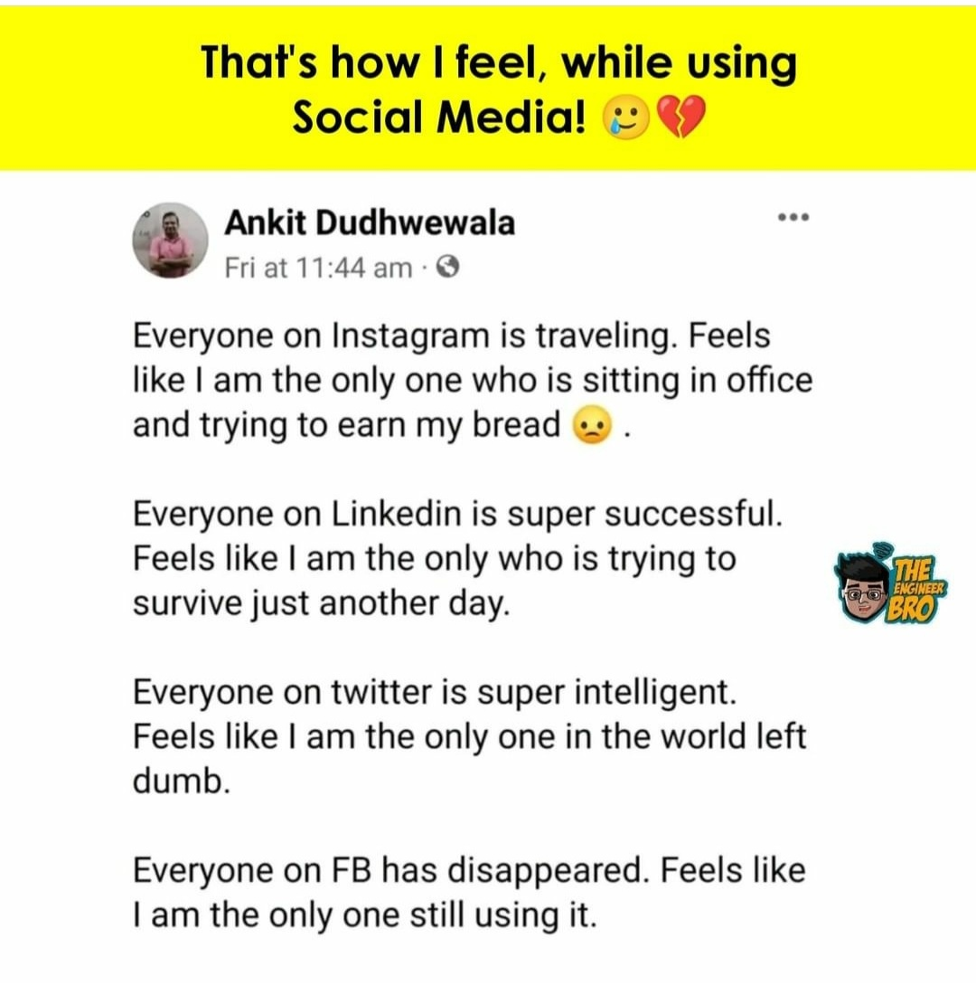
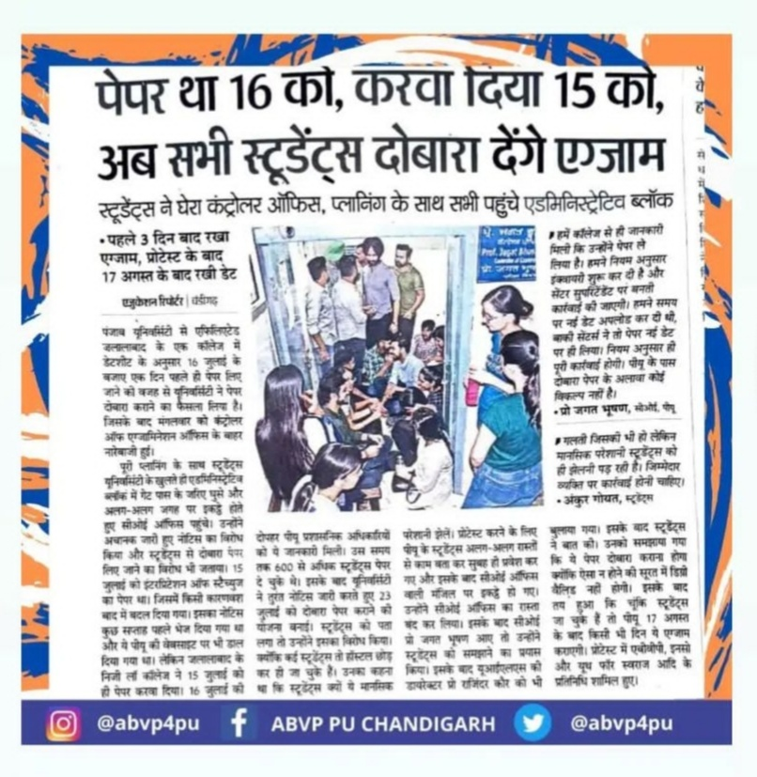
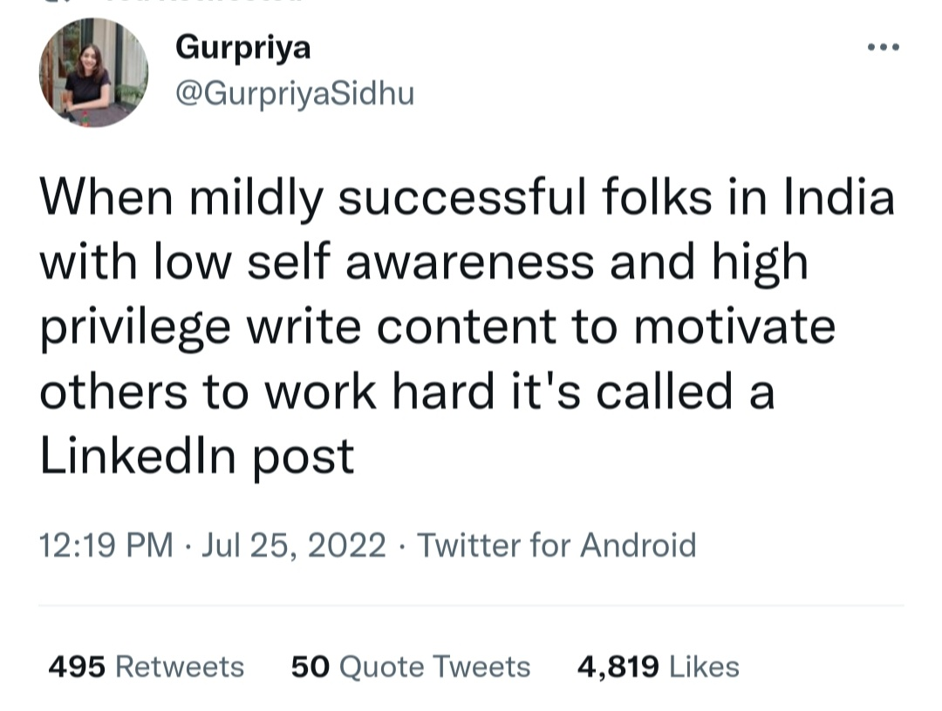
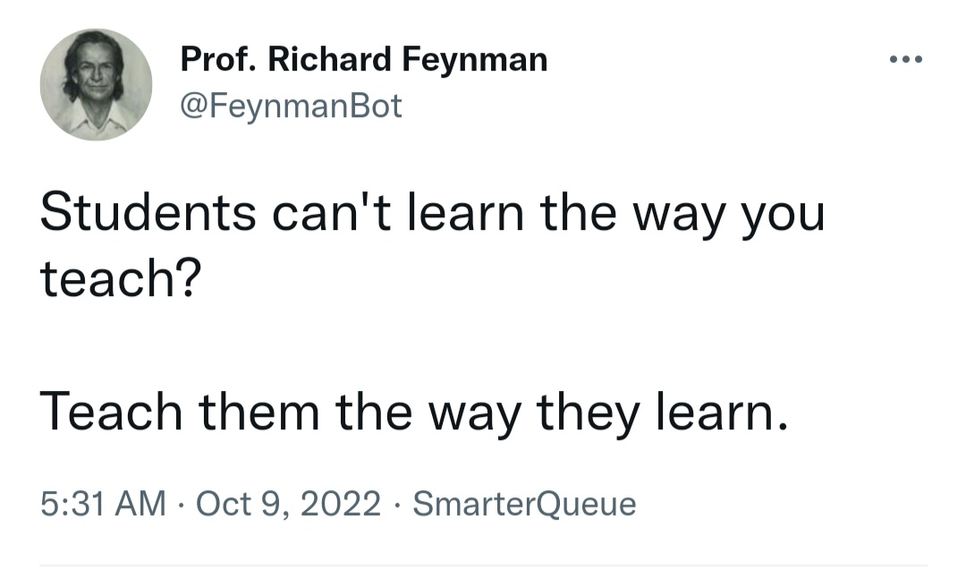

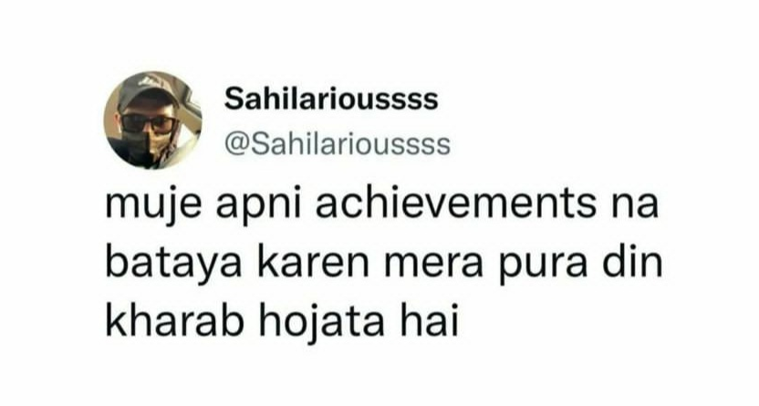

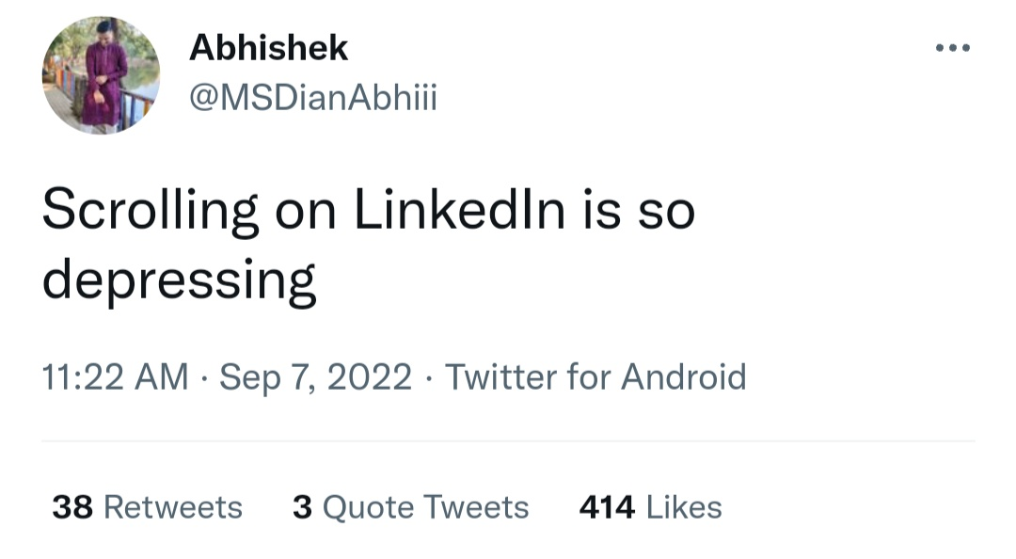


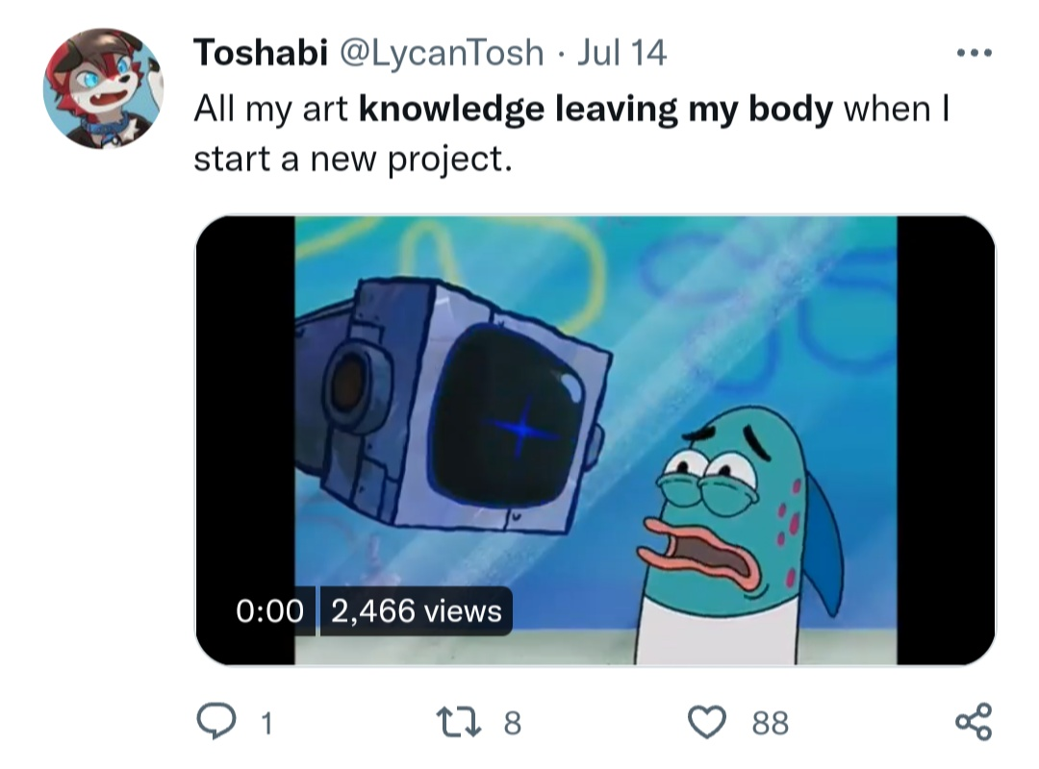
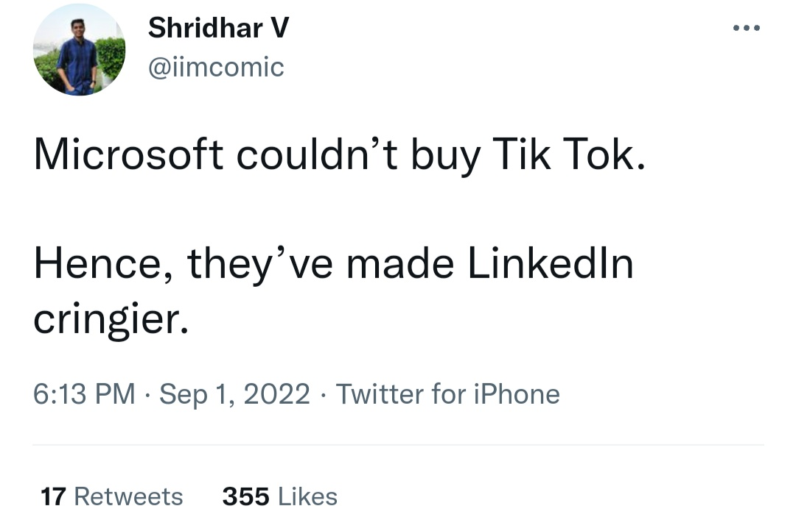
Idea Validation
Thought : Some Recent Memes & Tweets of people who face the problem that appeared on my newsfeed.

Slide 14
51,649
3,70,40,000
88,50,00,000
15,00,000
That’s a lot of higher educational institutes(After 12th)
That’s a lot of Schools (Before 12th)
Students(Age: 18-23)
Students(Age: 14-18)
Reported by MHRD Ministry of India in 2020 & 2001

Slide 15
?
Total Number of Learners
Thought: Every Learner can use it to learn and retain better.

Slide 16
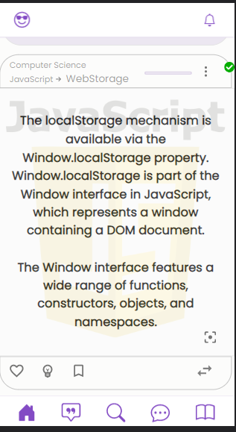
Mobile project
Mobility Mode ON

Slide 17
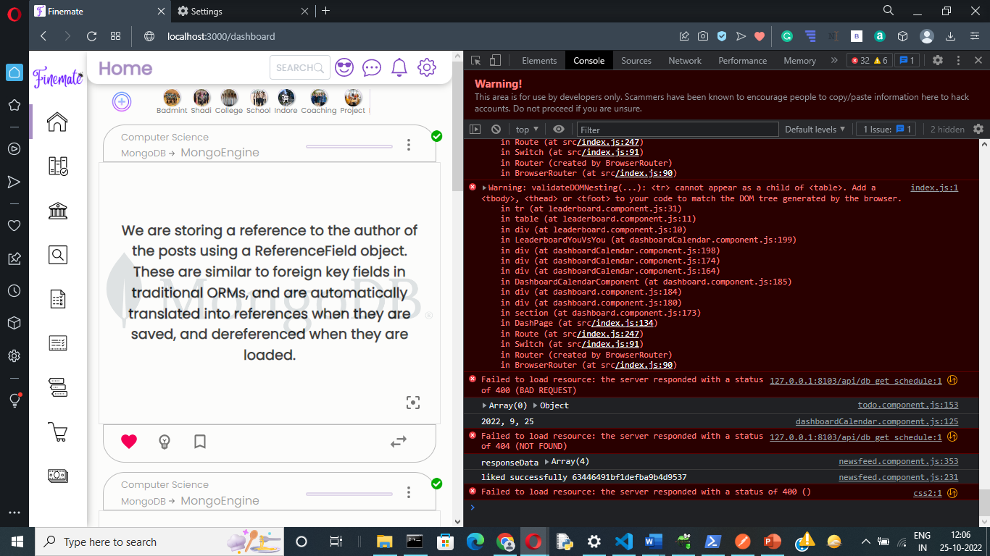
Tablet project
Leacture Mode ON

Slide 18
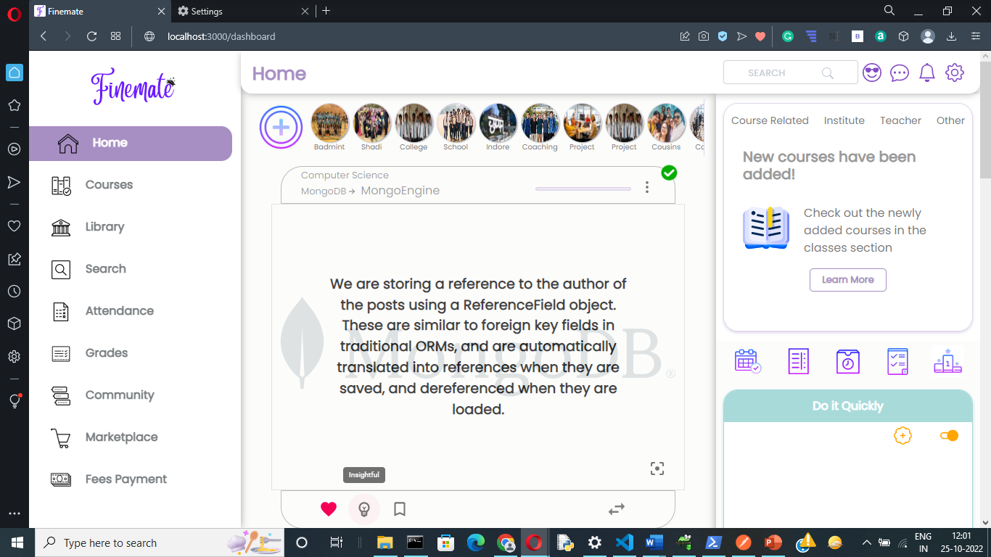
Desktop project
Study Mode ON

Slide 19
Business Model
Subscription Fee from Institutes
For Student Management System along with better Learning & Retention Solution.
Network
Leveraging network of students community to later capitalize from advertisement.
Marketplace
To promote students to earn pocket money by selling artworks, used stationary like books, calculators etc to peers or students from other institutes.

Slide 20

Team
Akshat Jain Bafna
An IT Engineer and a Solopreneur who is intrinsically motivated to solve the problem of Retention and Cognition.
Bachelor in IT from SVVV, Indore
(2018-22)

Slide 21
Thanks!
Any questions? You can find me at:
Email: akshatbjain.aj@gmail.com
Twitter: akshatjainbafna
LinkedIn: akshat-jain-571435139

